Slide 1
Preparing ahead of time for your 1st Adobe Connect session
NSF TUES Project Team:
Old Dominion University
Wayne State University
Bellingham Technical College
Blue Ridge Community College
Tidewater Community College
Summer 2014
Notes:
This template can be used as a starter file for presenting training materials in a group setting.
Sections
Right-click on a slide to add sections. Sections can help to organize your slides or facilitate collaboration between multiple authors.
Notes
Use the Notes section for delivery notes or to provide additional details for the audience. View these notes in Presentation View during your presentation.
Keep in mind the font size (important for accessibility, visibility, videotaping, and online production)
Coordinated colors
Pay particular attention to the graphs, charts, and text boxes.
Consider that attendees will print in black and white or grayscale. Run a test print to make sure your colors work when printed in pure black and white and grayscale.
Graphics, tables, and graphs
Keep it simple: If possible, use consistent, non-distracting styles and colors.
Label all graphs and tables.

Slide 2
What you will need:
A high speed internet connection
Notes:
Give a brief overview of the presentation. Describe the major focus of the presentation and why it is important.
Introduce each of the major topics.
To provide a road map for the audience, you can repeat this Overview slide throughout the presentation, highlighting the particular topic you will discuss next.

Slide 3

What “kind” of High Speed Network?
Must be Cable or Phone Company High Speed connection.
  Satellite or Dial-up is not allowed.
Notes:
This is another option for an Overview slides using transitions.

Slide 4
What “kind” of High Speed Network?
Must be Cable or Phone Company High Speed connection.
  Satellite or Dial-up is not allowed.
If on a wireless network at home, it is preferred that you get a cable and connect directly to your modem.
Notes:
This is another option for an Overview slides using transitions.

Slide 5
What “kind” of High Speed Network?
Must be Cable or Phone Company High Speed connection.
  Satellite or Dial-up is not allowed.
If on a wireless network at home, it is preferred that you get a cable and connect directly to your modem.
Connections at work might not work. If the system is behind a firewall, the firewall may prevent the necessary access.
Notes:
This is another option for an Overview slides using transitions.

Slide 6
What you will need:
A high speed internet connection
A Headset with a boom mic
Notes:
Give a brief overview of the presentation. Describe the major focus of the presentation and why it is important.
Introduce each of the major topics.
To provide a road map for the audience, you can repeat this Overview slide throughout the presentation, highlighting the particular topic you will discuss next.

Slide 7
Why not just use the built in speakers in the computer?
Because there will be times when there this will cause feedback into the system. This is important. As far as the boom mic, this is optional. You can use the built-in mic or the one in your webcam.
This is supplied to you for the WORKSHOP.
Notes:
This is another option for an Overview slides using transitions.

Slide 8
What you will need:
A high speed internet connection
A Headset with a boom mic
A Web-cam with microphone and software for displaying the camera output on the desktop.
Notes:
Give a brief overview of the presentation. Describe the major focus of the presentation and why it is important.
Introduce each of the major topics.
To provide a road map for the audience, you can repeat this Overview slide throughout the presentation, highlighting the particular topic you will discuss next.

Slide 9
What kind of web-cam?
There are lots of web-cams on the market. Choose one which is advertised as High-definition (the higher the pixels the better).
Most have a built-in microphone.
They MUST have the available software for displaying on the desktop.
THIS IS SUPPLIED TO YOU FOR THE WORKSHOP.
Notes:
This is another option for an Overview slides using transitions.

Slide 10
What you will need:
A high speed internet connection
A Headset with a boom mic
A Web-cam with software for displaying the camera output on the desktop.
The supplied web link. EXAMPLEs of such the link would be: https://connect.odu.edu/june25_workshop/
https://connect.odu.edu/july14_workshop/
https://connect.odu.edu/august4_workshop/
Notes:
Give a brief overview of the presentation. Describe the major focus of the presentation and why it is important.
Introduce each of the major topics.
To provide a road map for the audience, you can repeat this Overview slide throughout the presentation, highlighting the particular topic you will discuss next.

Slide 11
What your will need:
The supplied web link. EXAMPLEs of such link would be:
https://connect.odu.edu/june25_workshop/
https://connect.odu.edu/july14_workshop/
https://connect.odu.edu/august4_workshop/
You may be asked to get a very small tripod (NOT supplied for the workshop) for mounting the webcam so it points DOWN onto your hardware. For this reason, built-in cams will not work. You can get the small ones at Best Buy in the camera section.
Notes:
Give a brief overview of the presentation. Describe the major focus of the presentation and why it is important.
Introduce each of the major topics.
To provide a road map for the audience, you can repeat this Overview slide throughout the presentation, highlighting the particular topic you will discuss next.

Slide 12
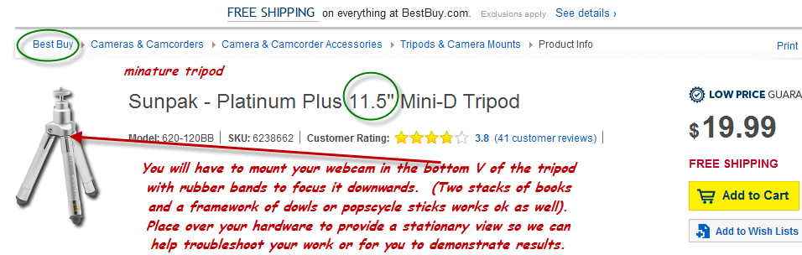
An example of a tripod which will work. This one is from Best Buy (on-line).
Trying to hold the camera over the hardware by hand “JUST WILL NOT WORK”. Most laptops with built-in cameras will not work for this purpose either (however, we have had some luck with some built-in HP’s).
Notes:
Give a brief overview of the presentation. Describe the major focus of the presentation and why it is important.
Introduce each of the major topics.
To provide a road map for the audience, you can repeat this Overview slide throughout the presentation, highlighting the particular topic you will discuss next.

Slide 13
What your will need:
A supported Web Browser. This is very important!
  Internet Explorer (IE10 or latest version)
  Mozilla Firefox (latest version)
  Do NOT use Google Chrome!
Both are free downloads. Note that if you are having issues with one, it helps to go to the other one.
No other Web Browsers will work! This is very important!
Notes:
Give a brief overview of the presentation. Describe the major focus of the presentation and why it is important.
Introduce each of the major topics.
To provide a road map for the audience, you can repeat this Overview slide throughout the presentation, highlighting the particular topic you will discuss next.

Slide 14
Sign-on and prepare your system WELL before the 1st workshop day.

Slide 15

Why?
Because there are several things which must be done to prepare your computer.

Slide 16

Paste the provided link into your Browser: (Either IE or Firefox).
Example:
https://connect.odu.edu/june25_workshop/
https://connect.odu.edu/july14_workshop/
https://connect.odu.edu/august4_workshop/

Slide 17
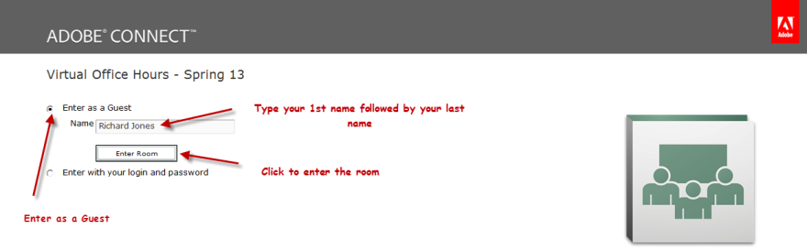
When you get there you will see:
Select “Enter as Guest”, type your full name in, and then “Enter Room”. Give 1st name and then last name.
Notes:
This is another option for an Overview slide.

Slide 18
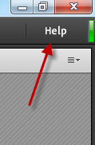
You will see a large workspace. The top will look as shown below.
Immediately select the “Help” menu in the right corner.
Notes:
This is another option for an Overview slide.

Slide 19
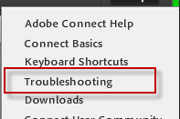
If it does not immediately launch into a computer test, then select “Troubleshooting.”
Notes:
This is another option for an Overview slide.

Slide 20
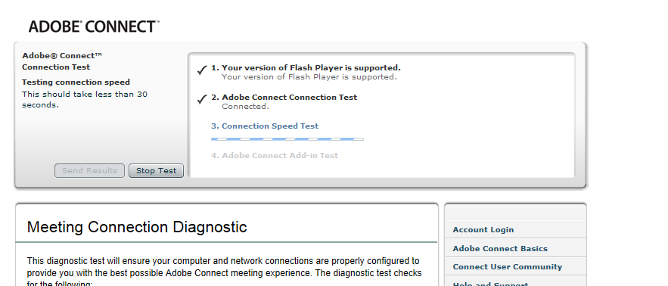
It will then go into a test of your system. If you have followed directions on your internet connection, it will reach the “Adobe Connect Add-in Test. (next slide)
Notes:
This is another option for an Overview slide.

Slide 21
When it asks you to install the “Adobe Connect Add-in”, DO SO. This is a ONE TIME ONLY THING.
Notes:
This is another option for an Overview slide.

Slide 22
If you are using IE and there is a problem with installing, then try Firefox. If that does not work let us know with a description of the problem. Communicate early so we can work things out without time pressure.
Notes:
This is another option for an Overview slide.

Slide 23
Now that the Add-in has been installed, you need to see if you can share your screen
Notes:
This is another option for an Overview slide.

Slide 24
In order for this to be tested, you must be shown as being a Presenter. The system should have automatically promoted you to “Presenter” when you came in. If it did not, then let us know.
Notes:
This is another option for an Overview slide.

Slide 25
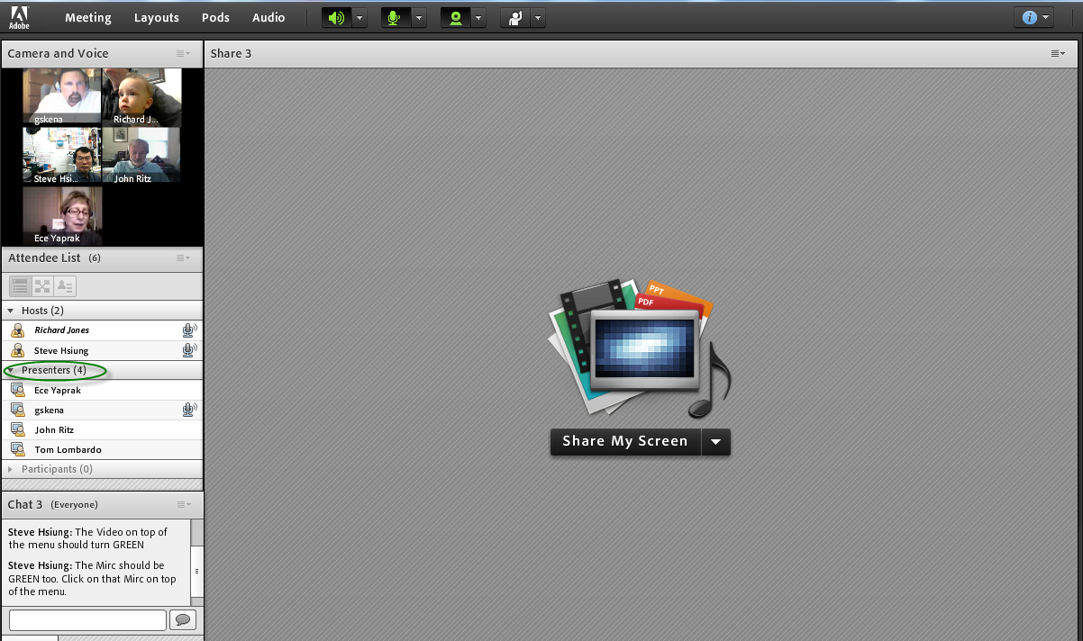
Notes:
This is another option for an Overview slide.

Slide 26
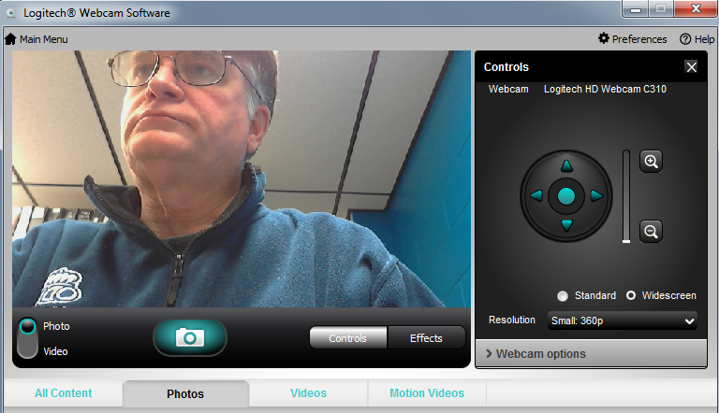
Make sure you have already started your web-cam software. Each program looks different. Mine looks like this on the Desktop.
Notes:
This is another option for an Overview slide.

Slide 27

You should see a “Share My Screen” in the middle of the workspace.
Notes:
This is another option for an Overview slide.

Slide 28
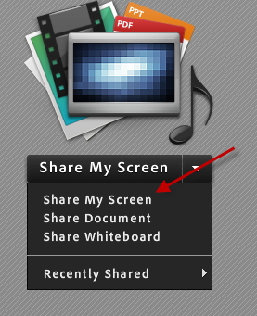
When you click on it you should see the following choices. For this test you should select “Share My Screen”.
Notes:
This is another option for an Overview slide.

Slide 29
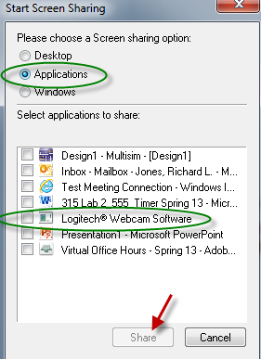
Select “Applications” and then find your running camera software in the list and place a check in front of it. Then select SHARE.
Notes:
This is another option for an Overview slide.

Slide 30
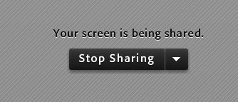
What you will see is shown below. This is different then what everyone else will see. In order for them to see anything, you need to drag your camera software window into the share window and size it.
Notes:
This is another option for an Overview slide.

Slide 31
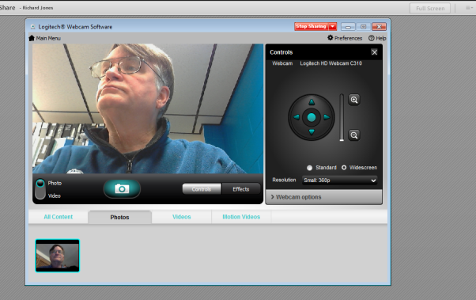
As long as you keep the software viewable in FRONT of the program, everyone will see it inside their share window. If it goes away, they will not.
Notes:
This is another option for an Overview slide.

Slide 32
If you click anywhere outside of the application, they will no longer see it. In fact, it might go behind your window as well.
Notes:
This is another option for an Overview slide.

Slide 33
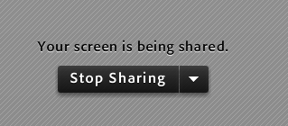
Once you are familiar with what to do, Stop Sharing and you are done.
Notes:
This is another option for an Overview slide.

Slide 34
You are only allowed to share your screen with us when asked.
This will normally be when you are wanting to demonstrate your hardware or have us troubleshoot it.
You can also share your simulator application for help with the simulation or your programming.
Notes:
This is another option for an Overview slide.

Slide 35
Note that you are also able to share the entire desktop, or individual documents. These are options that you might need to use during the course of the workshop.
Notes:
This is another option for an Overview slide.

Slide 36
Note that this takes up bandwidth which your TSP may nor have available for you. It might help to not have your camera on unless you are sharing it.
Notes:
This is another option for an Overview slide.

Slide 37
This should be all that needs to be done in advance
Notes:
Use a section header for each of the topics, so there is a clear transition to the audience.

Slide 38
Now lets look at what has to happen at the beginning of each class.
Notes:
Use a section header for each of the topics, so there is a clear transition to the audience.

Slide 39
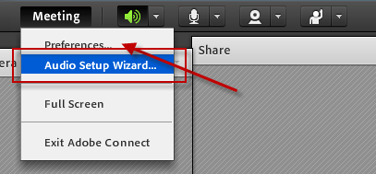
Come early to the class with your headset and your mic already hooked up.
Immediately go to the “Audio Setup Wizard”
Notes:
Keep it brief. Make your text as brief as possible to maintain a larger font size.

Slide 40
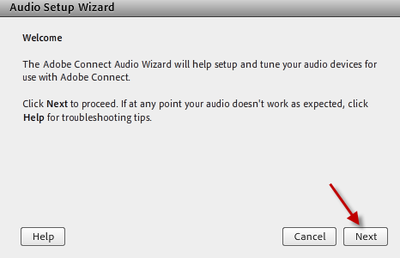
It will run the system thru a series of test which are self-explanatory. Make the necessary adjustments.

Slide 41
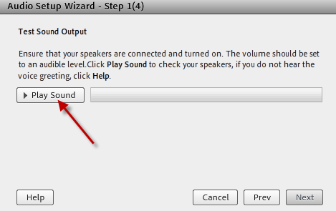
Select “Play Sound” and listen for the music in your headset.

Slide 42
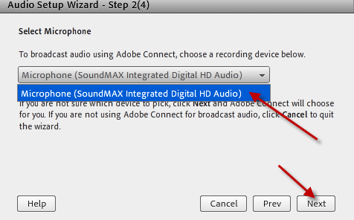
Select your microphone from the list.

Slide 43
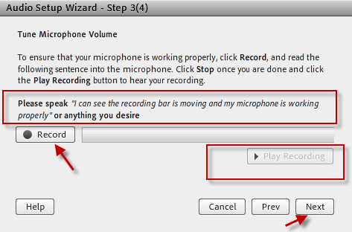
Test your microphone here.

Slide 44
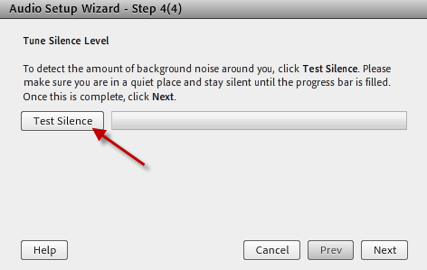
Set it to block out the BACKGROUND noise.

Slide 45
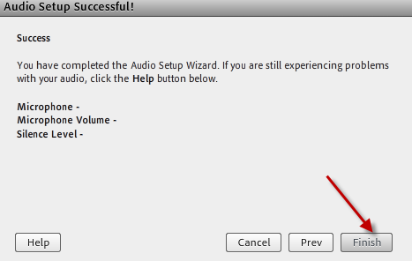
Select “Finish”.

Slide 46
WARNING!!!!!
Make sure that no-one in your house-hold (if you are working on a private home network):
  Is watching any Internet movies
  Playing any internet games
… for the entire workshop day. The system will need as much BANDWIDTH as you can give it.
Notes:
If there is relevant video content, such as a case study video, demo of a product, or other training materials, include it in the presentation as well.

Slide 47
Lets look at the rest of the controls at the top of the screen.

Slide 48

There are several controls at the top of the workspace:
The button to mute your speakers. You should normally leave this alone.
Notes:
If there is relevant video content, such as a case study video, demo of a product, or other training materials, include it in the presentation as well.

Slide 49
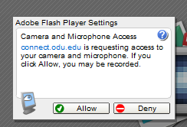
There are several controls at the top of the workspace:
The microphone button. The 1st time you select it in a session it will show a popup in which you should select ‘Allow’.
Notes:
If there is relevant video content, such as a case study video, demo of a product, or other training materials, include it in the presentation as well.

Slide 50


There are several controls at the top of the workspace:
The microphone is on when it is green.
You should keep it muted when you are not using it. THIS IS VERY IMPORTANT FOR THIS WORKSHOP TO RUN SMOOTHLY.
Notes:
If there is relevant video content, such as a case study video, demo of a product, or other training materials, include it in the presentation as well.

Slide 51
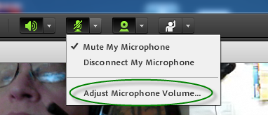
There are several controls at the top of the workspace:
It is possible we will not be able to hear you well enough. If so, click on the arrow next to the mic and select: Adjust Microphone volume….
Notes:
If there is relevant video content, such as a case study video, demo of a product, or other training materials, include it in the presentation as well.

Slide 52

There are several controls at the top of the workspace:
Don’t turn your camera on unless asked. The more cameras running, the less bandwidth is available for what the workshop needs to do. It might prevent window sharing!
Notes:
If there is relevant video content, such as a case study video, demo of a product, or other training materials, include it in the presentation as well.

Slide 53
There are several controls at the top of the workspace:
While it might seem nice to have all of the workshop attendees showing on the screen, it is usually counter productive.
Notes:
If there is relevant video content, such as a case study video, demo of a product, or other training materials, include it in the presentation as well.

Slide 54
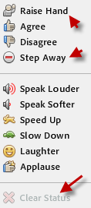
There are several controls at the top of the workspace:
And finally, there are the icons. The most important ones are the
Raise Hand and
Step Away
icons.
When you select one it will appear next to your name in the name list to get the leaders attention.
Notes:
If there is relevant video content, such as a case study video, demo of a product, or other training materials, include it in the presentation as well.

Slide 55
That should complete the introduction. We are looking forward to meeting you on-line on ADOBE CONNECT.

Slide 56
The keys to making this workshop a success is to be patient, attentive, and flexible.

Slide 57
Above all, do as much prep work as possible. Attempting the labs ahead of time and having a list of questions helps a lot!!!!

Slide 58
The Followings are the contacts, if you have any problem: If you have any issue contact us immediately!
ODU: Steve Hsiung, (757)683-4606 shsiung@odu.edu
ODU: Richard Jones, (757)683-3775 rljones@odu.edu
ODU: John Ritz, (757)683-5226 jritz@odu.edu
WSU: Ece Yaprak, (313)577-8075 yaprak@wayne.edu
BRCC: Jim Eiland, (540)234-9261-X2274 EilandJ@brcc.edu
TCC: Tom Stout, (757)822-5230 tstout@tcc.edu
TCC: Richard Seriani , (757)410-7889 rseriani@tcc.edu
BTC: Sam Cheung, (360)752-8455 scheung@btc.ctc.edu
ONU: Feng Jao, (419)634-3679 web and server adm
f-jao@onu.edu
Notes:
CSUF: Reza Raeisi, (559)278-6038 rraeisi@csufresno.edu
ODU: Steve Hsiung, (757)683-4606, shsiung@odu.edu
ODU: Richard Jones, (757)683-3775 rljones@odu.edu
ODU: John Ritz, (757)683-4305 jritz@odu.edu
WSU: Ece Yaprak, (313)577-8075 yaprak@wayne.edu
BRCC: Jim Eilan, (540)234-9261 Ext. 2274 EilandJ@brcc.edu
TCC: Tom Stout, (757)822-5230 tstout@tcc.edu
TCC: ichard Seriani , (757)410-7889 rseriani@tcc.edu

