Slide 1

Pairing Bluetooth Radio with onn. Tablet
Jackson State University

Slide 2
What we are doing…
Describe Bluetooth technology
Identify applications of Bluetooth technology
Show what is needed for a Bluetooth connection
Set up Onn. Tablet to “scan” for Bluetooth device
Identifying and paring a Bluetooth device
Enter device PIN identification
Making the Bluetooth Connection

Slide 3
What is Bluetooth?
Bluetooth is a wireless technology that allows the exchange of data over short distances…
Examples… Bluetooth ear buds, hands-free phone in your car, smart watches and mice and keyboards and other “wireless” devices…
Bluetooth devices must be “paired” to communicate with each other – a host and client

Slide 4
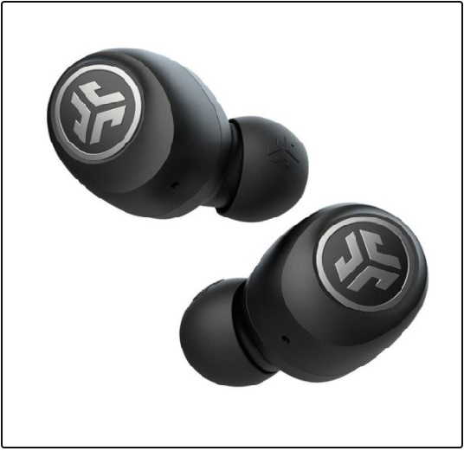
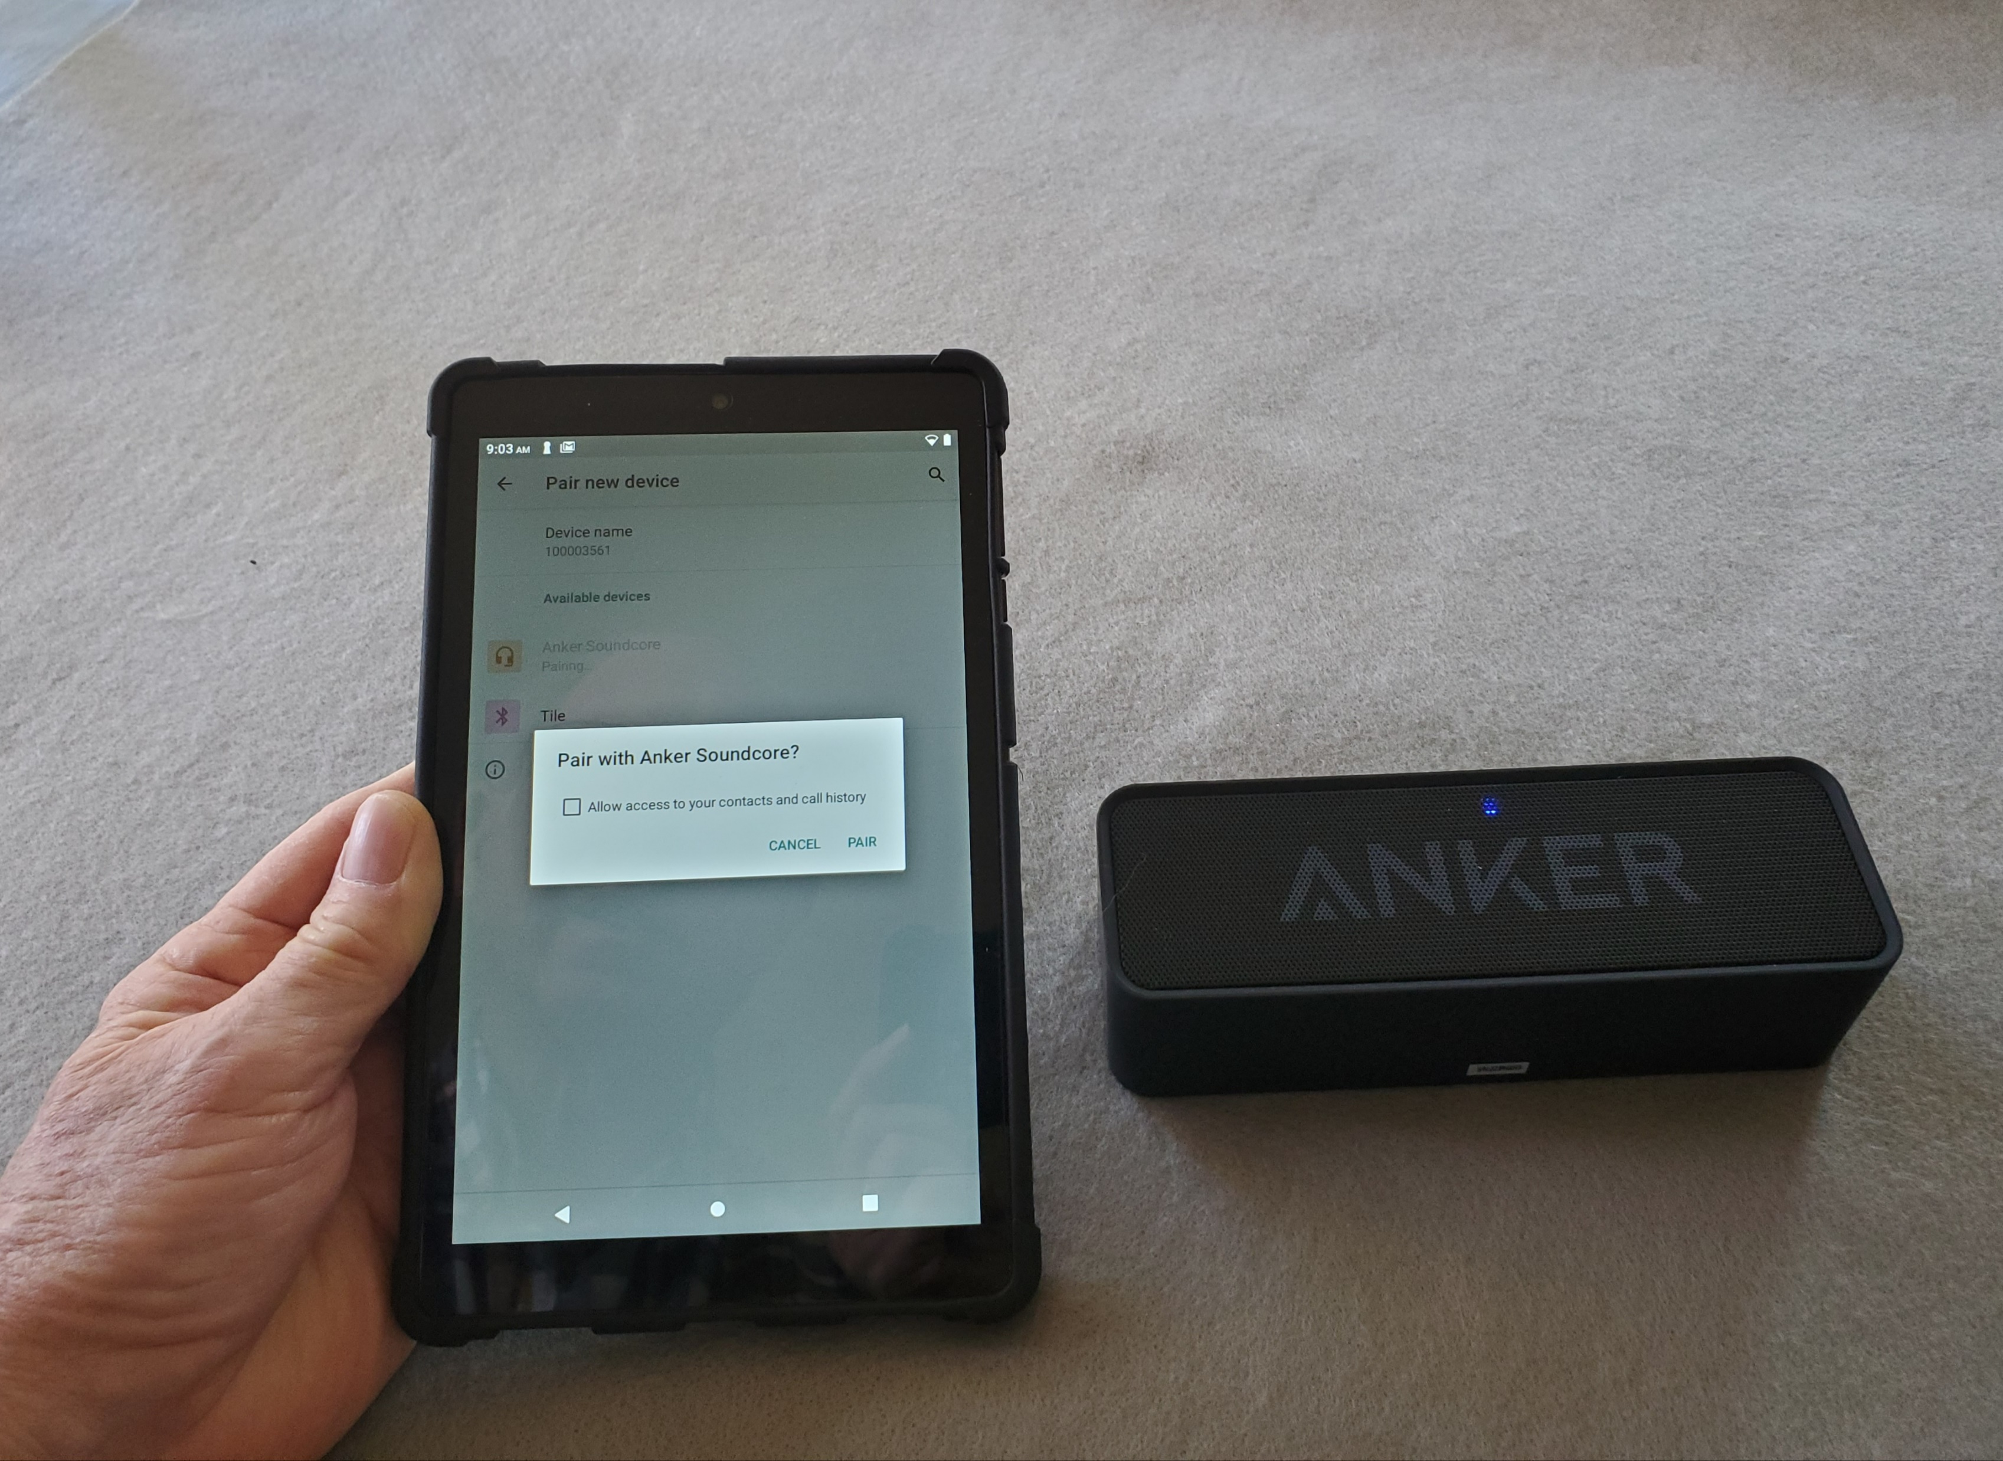
What is needed?
Bluetooth device – Example – Jlab Bluetooth 5.0 Ear Buds
Pairing a Bluetooth speaker with onn. Tablet…

Slide 5
Paring Bluetooth…
Some Bluetooth devices automatically pair…
Other devices have security requirements…
PIN numbers are used as “pass codes” or passwords
The “hosting: device must “scan” for new devices
Client devices – phones, ear buds & etc. must be “discoverable.”
Once paired devices may automatically connect…

Slide 6
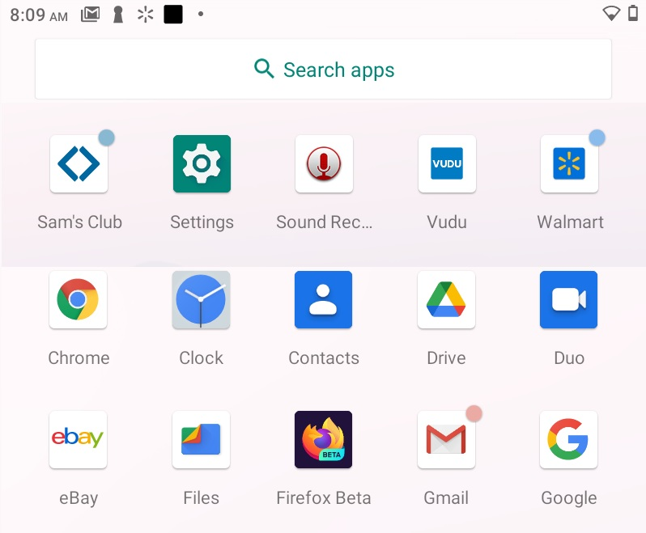
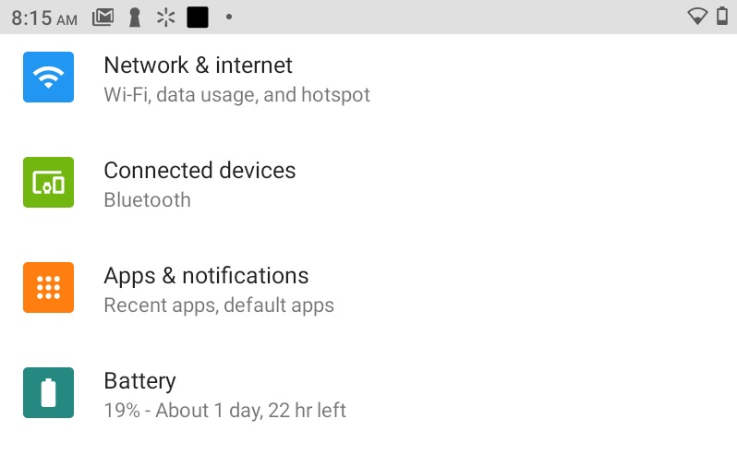
Getting Started
Turn ON both devices – Tablet and Bluetooth radio
On your tablet go to SETTINGS and select Connected devices Bluetooth…

Slide 7
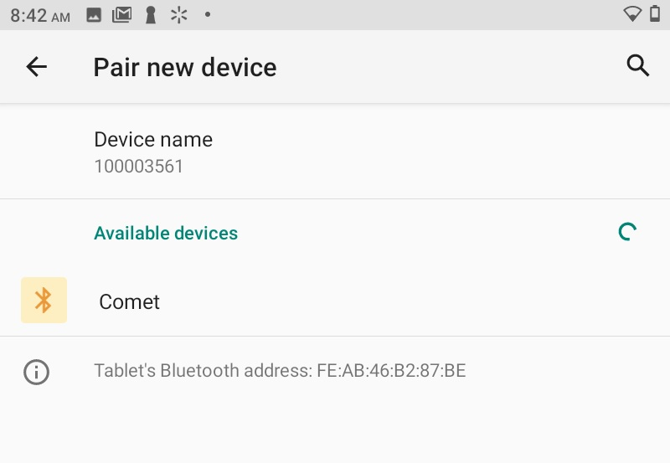
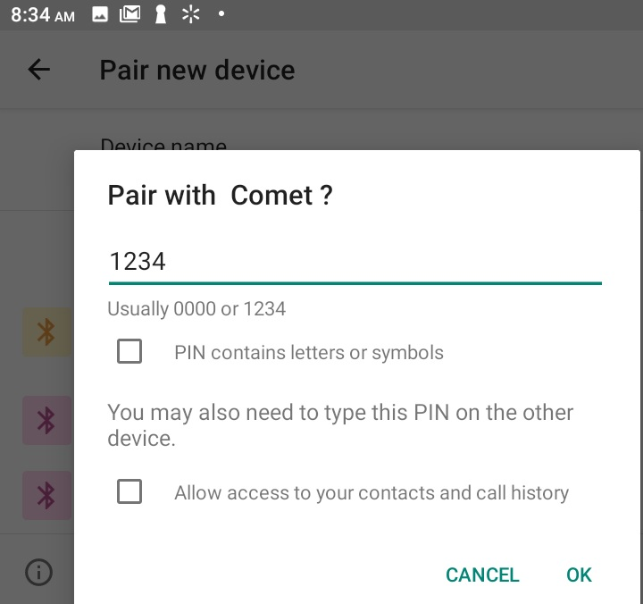
Pair New Device
Select the device name
Your device name is on the back of the radio (JSU_RoverXX)
Enter PIN number – 1234
Click OK

Slide 8
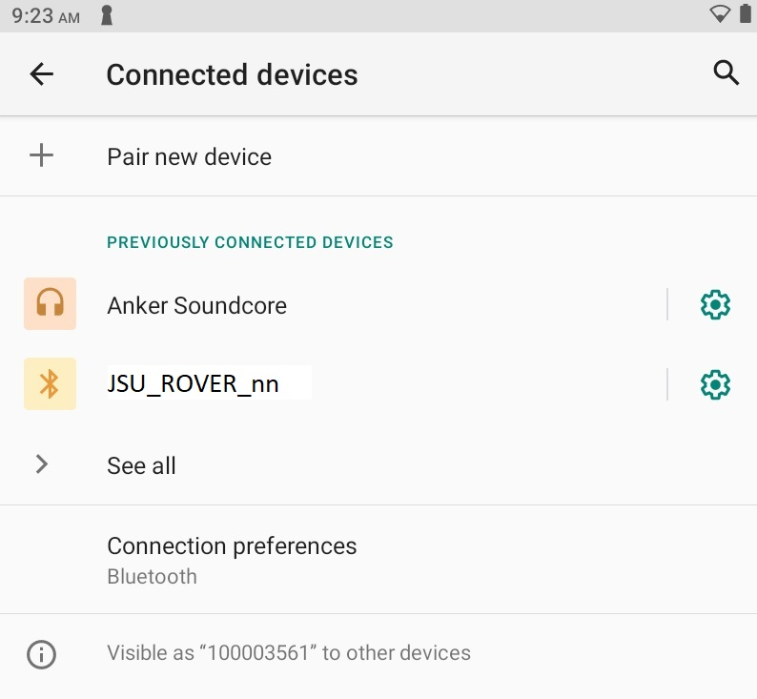
Connected Devices on Tablet
Devices paired will be displayed as shown – your Rover Bluetooth device will be displayed as:
JSU_ROVER_nn
nn = number from 1 to 35

Slide 9
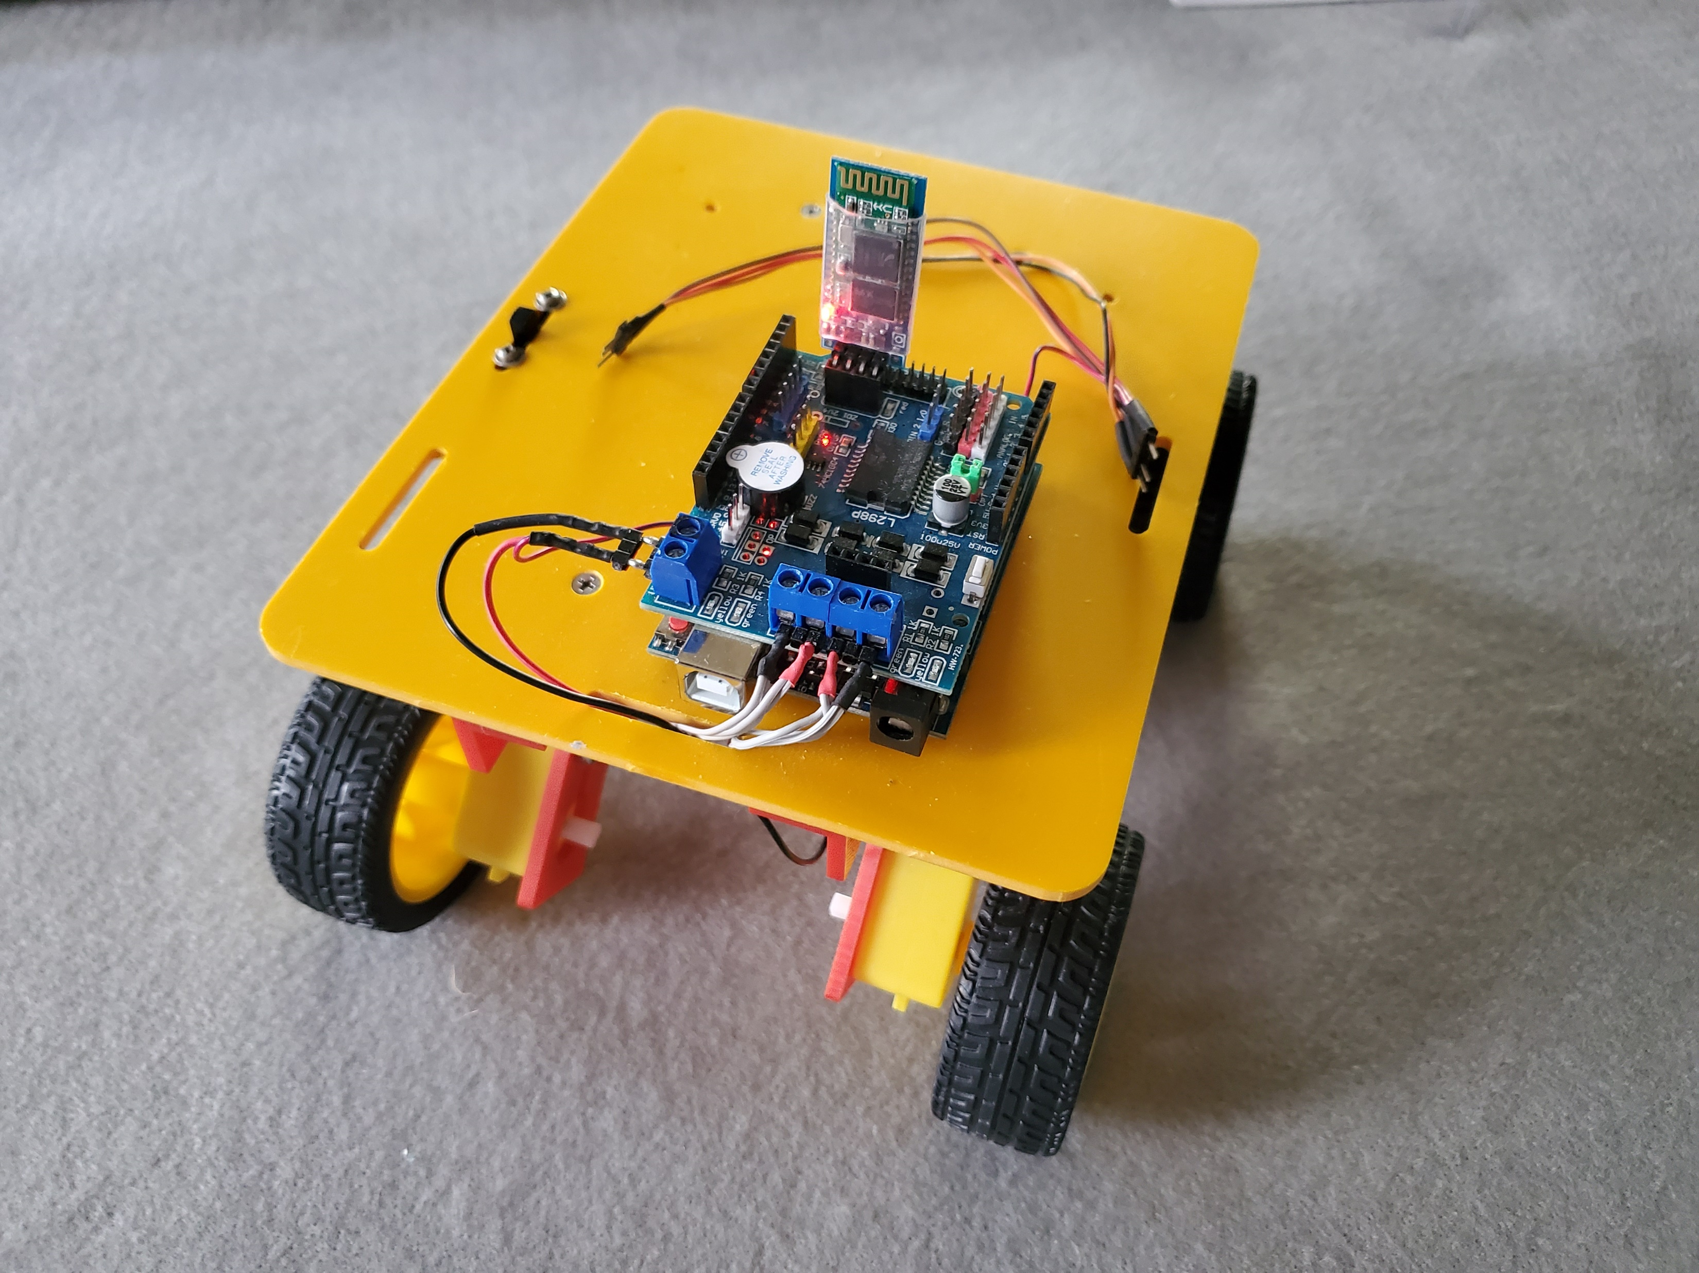
Paring Rover
Power ON
Blinking red LED
Sometimes connection may fail – just repeat process

Slide 10
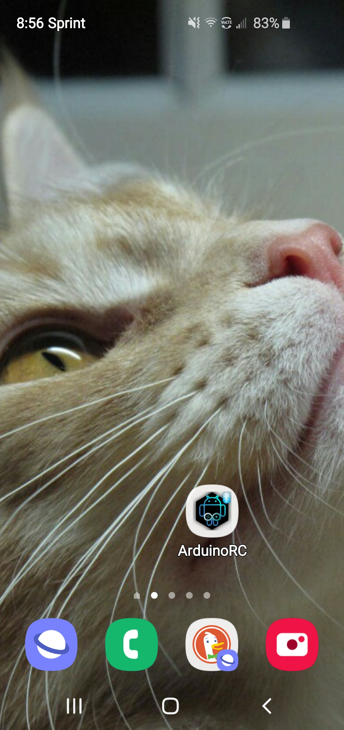
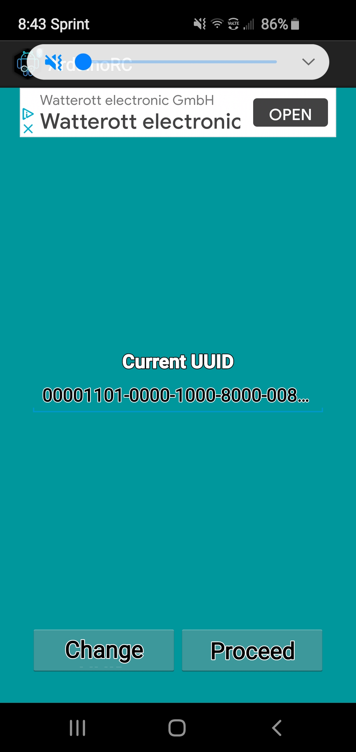
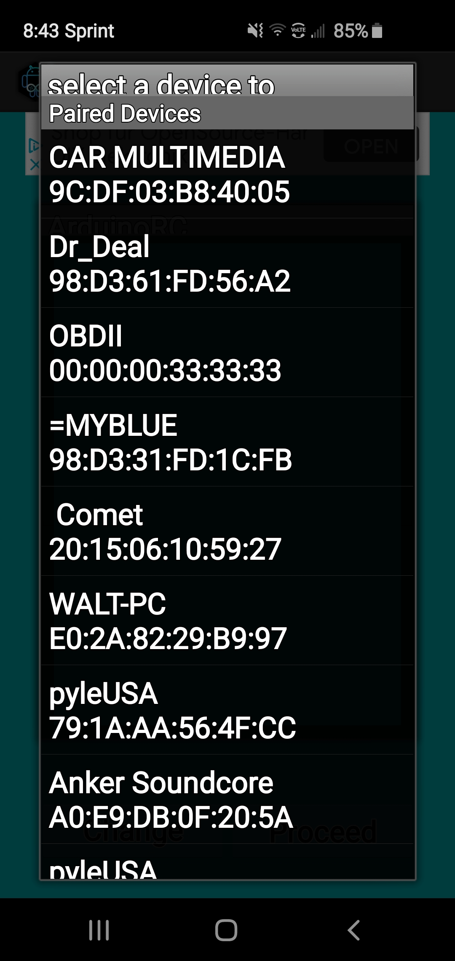
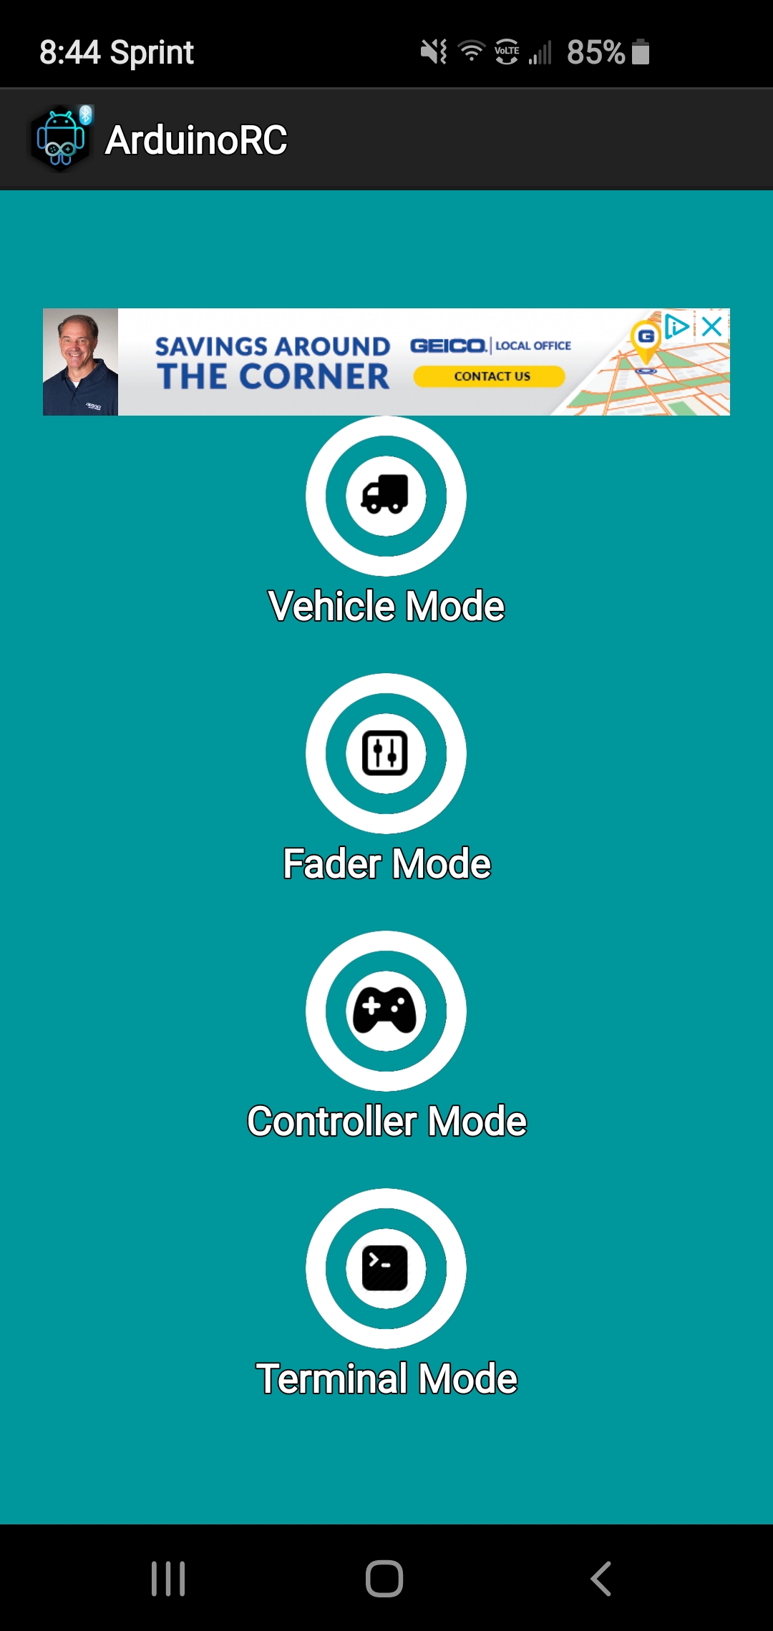
Connecting to Rover…

Slide 11
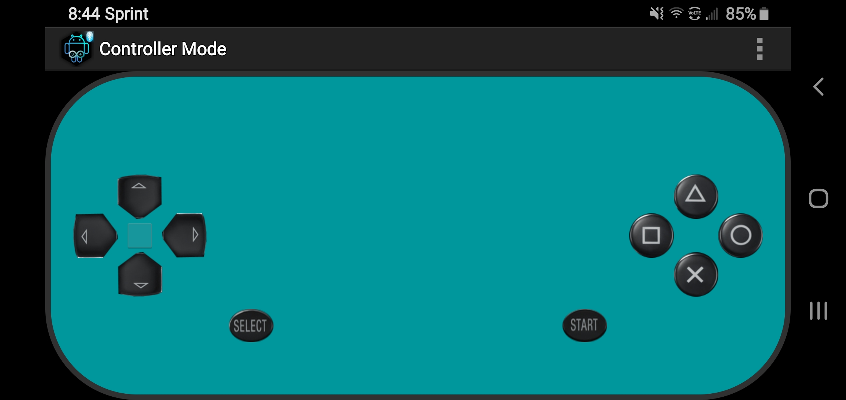
Rover Control
Forward
Up
Left
Right
Left
Right
Home
Camera
Down
Back
Stop
Rover Control
Camera Control
Next
Click Here

Slide 12
Rover Video…
Rover Control
Camera Control
Next

Slide 13
Summary
What is Bluetooth?
Identify at least three Bluetooth devices…
What are the basic steps to pair a device?
  Power-ON devices
  Settings – Connections – Bluetooth
  Scan for new device
  Pair device – manually or automatically
  Enter pass code PIN as necessary

